Slide 1





Team DoingNow
Caleb Cheong
Lew Yong Jiun
Brandon Christopher
Gerald Lee
Ching Rou
Project: Jerry Marcus's new best friend

Slide 2
Description: Proposed Solution
Plug-and-Play Editor (Beginner-Friendly)
Easy to create Automated Trading Models – without knowing a line of code
Eliminate long and manual Technical Analysis work
Large variation of Technical Indicators to build your strategy (full control)
Work with Historical and Real-Time trading data (scalable timeline)
Risk Mitigation
Strategize
(Choose Indicators)
Logic Builder
(Define Actions)
Back-Testing
(Win-Lose Rate)
Implement
(Roll out Trading Model in real-time)
Notes:
Traditionally, users needs to know how to code to create their own program. But WIX disrupted that line of thinking and change the world of web programming. Like Wix, a plug-and-play editor to create a professional website, Jerry is a editor to create and test automated trading models, without knowing a line of code.
Traders of all levels can now leverage on Algorithmic Trading with little to no knowledge in Quantitative Finance, thus eliminating long and manual technical analysis work. Jerry provides a large variation of technical indicators for users to strategize, build and test their own trading models.
As a form of Risk Mitigation, We provide users with Historical Trading data to Back-Test their Trading models on its effectiveness before real-time implementation on the market.

Slide 3
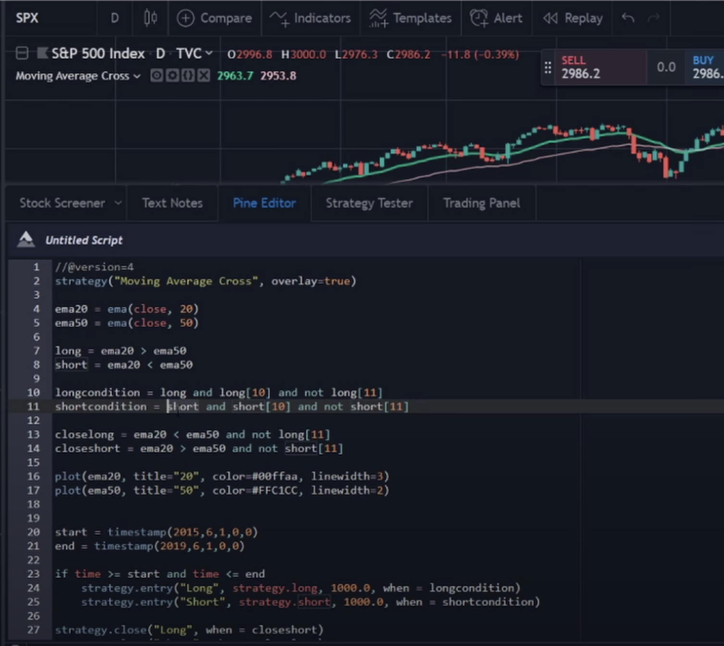
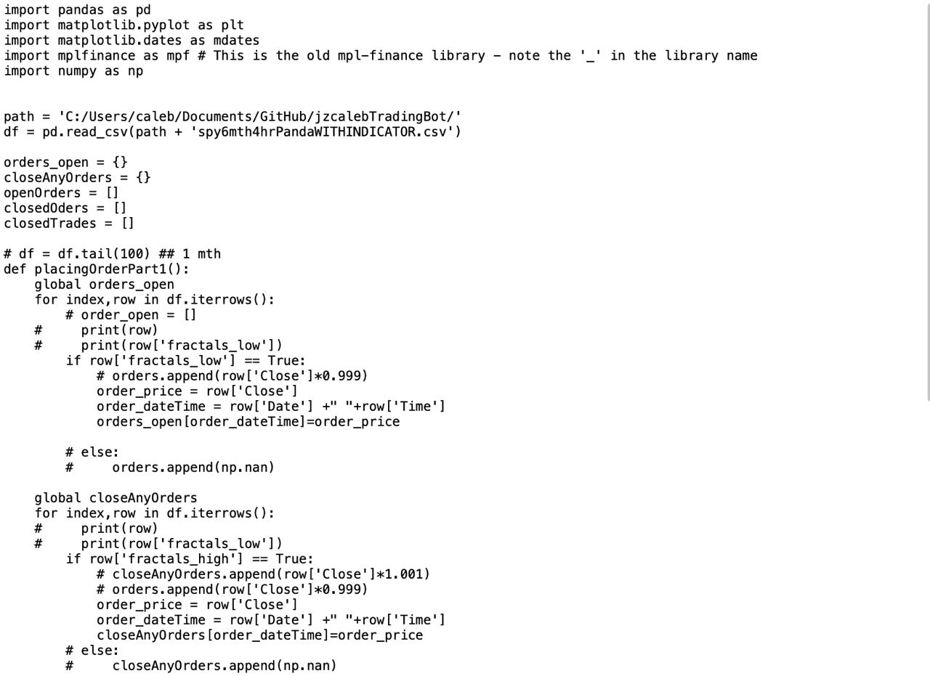
Business Case
Strategic Context: Revolutionize the way automated trading models are created.
Eliminate traditional manual process of programming your own trading model
Bridge skill gaps between traders of all level
Equal playing field for all --> Inclusive trading community
Commercial Approach: API & Software-as-a-Service (SaaS)
Individuals
Institutions / Organizations
Subscription business model
Notes:
Strategic context: The compelling case for change. justification for undertaking a project
Quantitative finance is a niche field where only quantitative traders can experience the benefit of automated trading models. Being able to trade while having a peace of mind in their sleep during market trading hours. This creates an uneven playing field among traders as the learning curve to create your own automated model is steep. Many seeks to benefit from it but struggles with tutorials to create their own Model.
We want to help bridge the skill gaps between traders of all levels by eliminating the traditional manual process of programming your own trading model. Our solution revolutionize the way models are created through plug and play inputs from users. Thus, creating a inclusive trading community for all that seeks to grow their money and diversify their finance portfolio.
Commercial approach:
In terms of commercial value, we can offer our API and our solution as a Software as a service to Individuals and institutions through a subscription business model.
Retail Investors can subscribe to our platform to generate their own automated trading model
While Instiutions can subscribe to our API to integrate it into their own platform. Our software can be use by them for employee training purposes.

Slide 4
Business Case
Economic analysis (Rough Estimation):
AWS DocumentDB | AWS EC2 | AWS S3 | Plotly (Dash Enterprise)
Size: db r4.16xlarge (64CPU, 488GiB) | Size: t4g.2xlarge ( 8vCPUs, 32GiB) | Size: 2TB. 1000000000 requests per month | Size: 5 creators, unlimited viewers
$8709.62 monthly | $167.90 monthly | $601.80 monthly | $4000 Monthly
Total Monthly Cost: $13,479.32
Trade, Execution Fees |  | Subscription of Solution fees
Rough Addressable Market Daily | Avg Brokerage Transaction Fees | Monthly Basis Subscription Fees | User Size
450000 | $5.00 | $10.00 | 1 Million
Total Monthly Revenue: 30(450000 * $5.00) + ($10.00 * 1 Million) = $77 Million
Notes:
Economic analysis: Return on investment based on investment appraisal of options.
This is the only bespoke solution that is available on the market.
Project 5 years of cost and revenue.
Revenue:
Total addressable market of Retail Trading in US is – 5Trillion * 10% = 500 B
How much commissions are brokerages charging for Retail Trading (You can use this for execution) - The per-trade flat fee ranges between $5 to $30 per trade.
How much are some trading courses/platform are people charging on a monthly basis Cost: - $100 - $150 per course
how much is being traded on stock market in US - 15.2 B * 0.2 % = 30 million
30 million * 1.5% = (how much u can address * comission fee) - execution fees + ((10 – 15 per month) * (1mi)) - how much people pay to use = 120 Million
160 Million
Caleb: DON NEED TO PUT PRODUCT PIPELINE. . I put in going forward liao ok

Slide 5
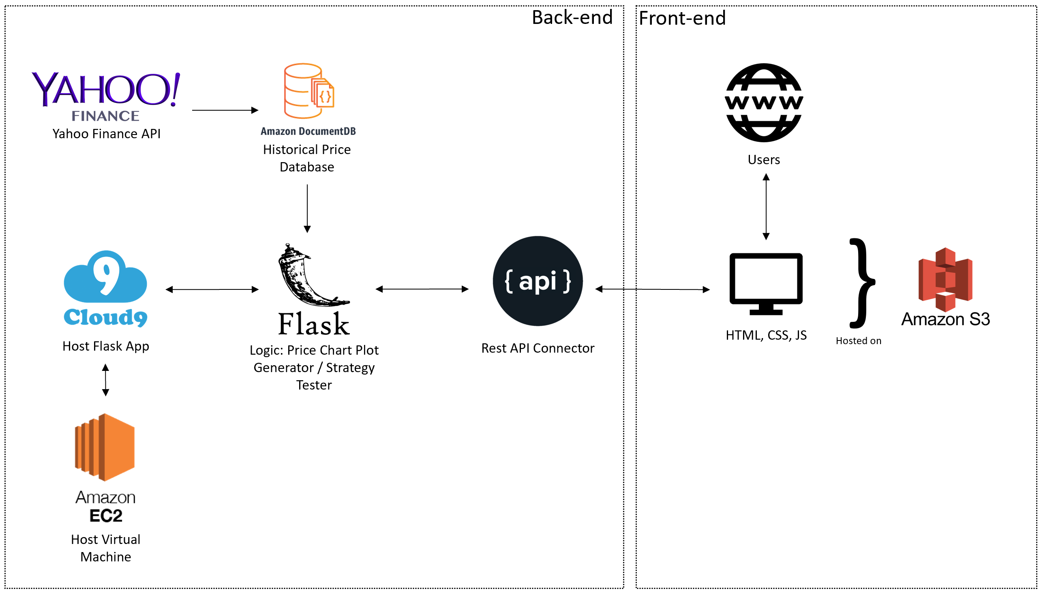
Solution Architecture
Notes:
Firstly, I will go through out back-end system.
1- We have an amazon document database that is loaded with historical stock prices. This data is pulled from Yahoo Finance API and pushed into the database.
-- Purpose : The purpose of the document database is to eliminate the high number of API calls to external APIs outside of AWS architecture to improve latency and reduce external dependencies
-- Limitation of POC : Due to the limitations of using a free API to pull historical stock prices, we are only able to pull 1.5 year of 1 day price data.
2- We have a AWS EC2 virtual machine that hosts a AWS cloud9 IDE
-- Purpose the AWS cloud 9 IDE is to host our flask app
3. The flask app is the brains of the backend system and ties the frontend system to the backend
-- The flask app has 3 purpose:
1. Generate a interactive price graph for the front end
2. Run back tests on strategy created by users
3. Host a REST Api to serve as the connector between front and back end
-- The flask app gets all its data from the AWS document DB
Next, the Front end system
1- the front end system is created on HTML, CSS and JS with plans to fully host it on AWS S3 server
At the moment due to technical implications we are not able to have the whole front end system hosted on AWS S3
Therefore, for the upcoming demo the front end will be on localhost and the backend will be on AWS architecture

Slide 6
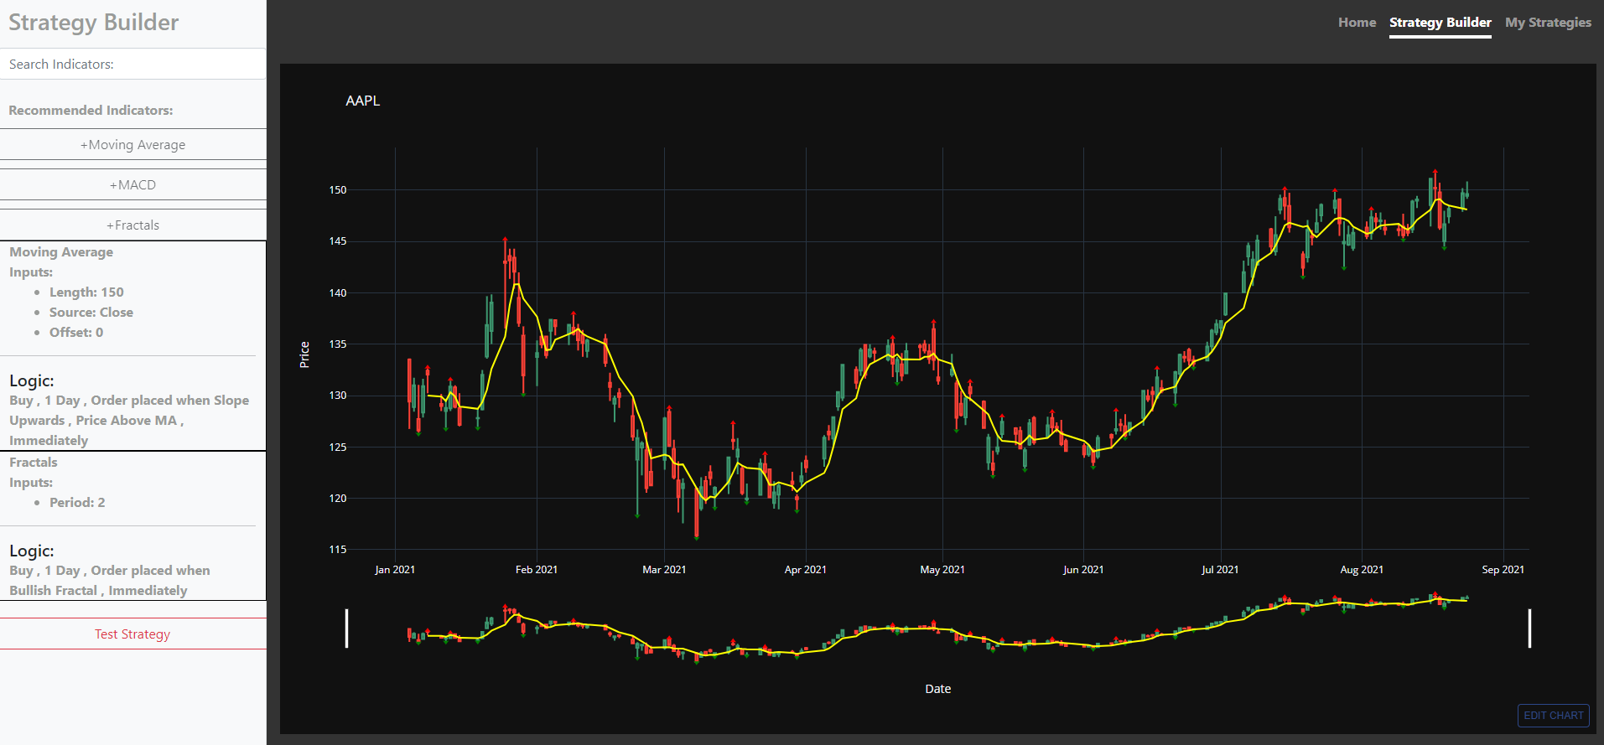
Feature 1 - Building Trading Strategies
Interactive UI w/Chart Visualization
Notes:
Our solution provides a interactive user interface with chart visualization for users to easily build and visualized strategies
- The chart display a open high low close candlestick chart, which is the most common method of visualizing price data allowing users to easily familerize them self with the UI.
- As a user adds or edits an indicator into their strategy, the chart will change accordingly to reflect the new logic created by the user

Slide 7
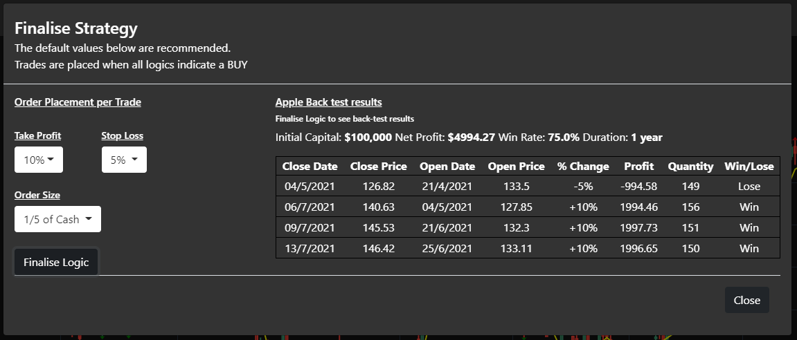
Feature 2 - Testing Trading Strategies
Automated Back Testing
With created strategies and order details, the system will back-test the strategy with 1 year of historical data
Notes:
Feature 2 testing trading strategy
Our solution provides a way for user's to quickly test their strategy so that they can effectively pump out strategies to meet their needs.
- with order details like risk reward ratio and size of each trade in the test, the system can automatically back end with 1 year of data
- limitation of POC, because the data is not very granular due to the free API we used.. The backtest result from the POC may not be accurate.

Slide 8
Demo
https://github.com/carleb/TeamdoingNow-EllipsisTechSeries2021

Slide 9
Limitations
Data limitation – The POC uses a cost-free API to get historical price data
Limited amount of data to improve the strategy building and testing process
Plotly limitation – The POC uses a free Plotly account
Limited number of graphs generated daily
Limited Technical Indicators – Only Fractals and Moving Average
As a POC, we decided to only allow this two indicators to create a strategy
The final product will allow users to use more indicators to create a more unique and complex strategy.

Slide 10
Going Ahead
Fixing the limitations
Adding more technical indicators and more complex logic customization
Remove the limit to the number of graphs created in the backend
Include a premium data source to increase granularity of data inputs
Strategies created can be imported to Goldman Sachs MARCUS's app
Strategies can be share around the community
Allow users to purchase strategies from each other, increasing the user base
Strategy creators may be paid a commission.
Possible customer-to-customer (C2C) business model
Expanding with additional financial instruments
Trade with Cryptocurrency, Forex, ETFs, etc.

Slide 11
References
Code References:
https://blog.stevenlevithan.com/archives/date-time-format
References:
https://www.cowen.com/insights/retail-trading-whats-going-on-what-may-change-and-what-can-institutional-traders-do-about-it/
https://calculator.aws/#/estimate
https://www.goldmansachs.com/investor-relations/financials/current/annual-reports/2018-annual-report/#:~:text=We%20are%20pleased%20with%20our,%245%20billion%20of%20consumer%20loans.

